Slide 1
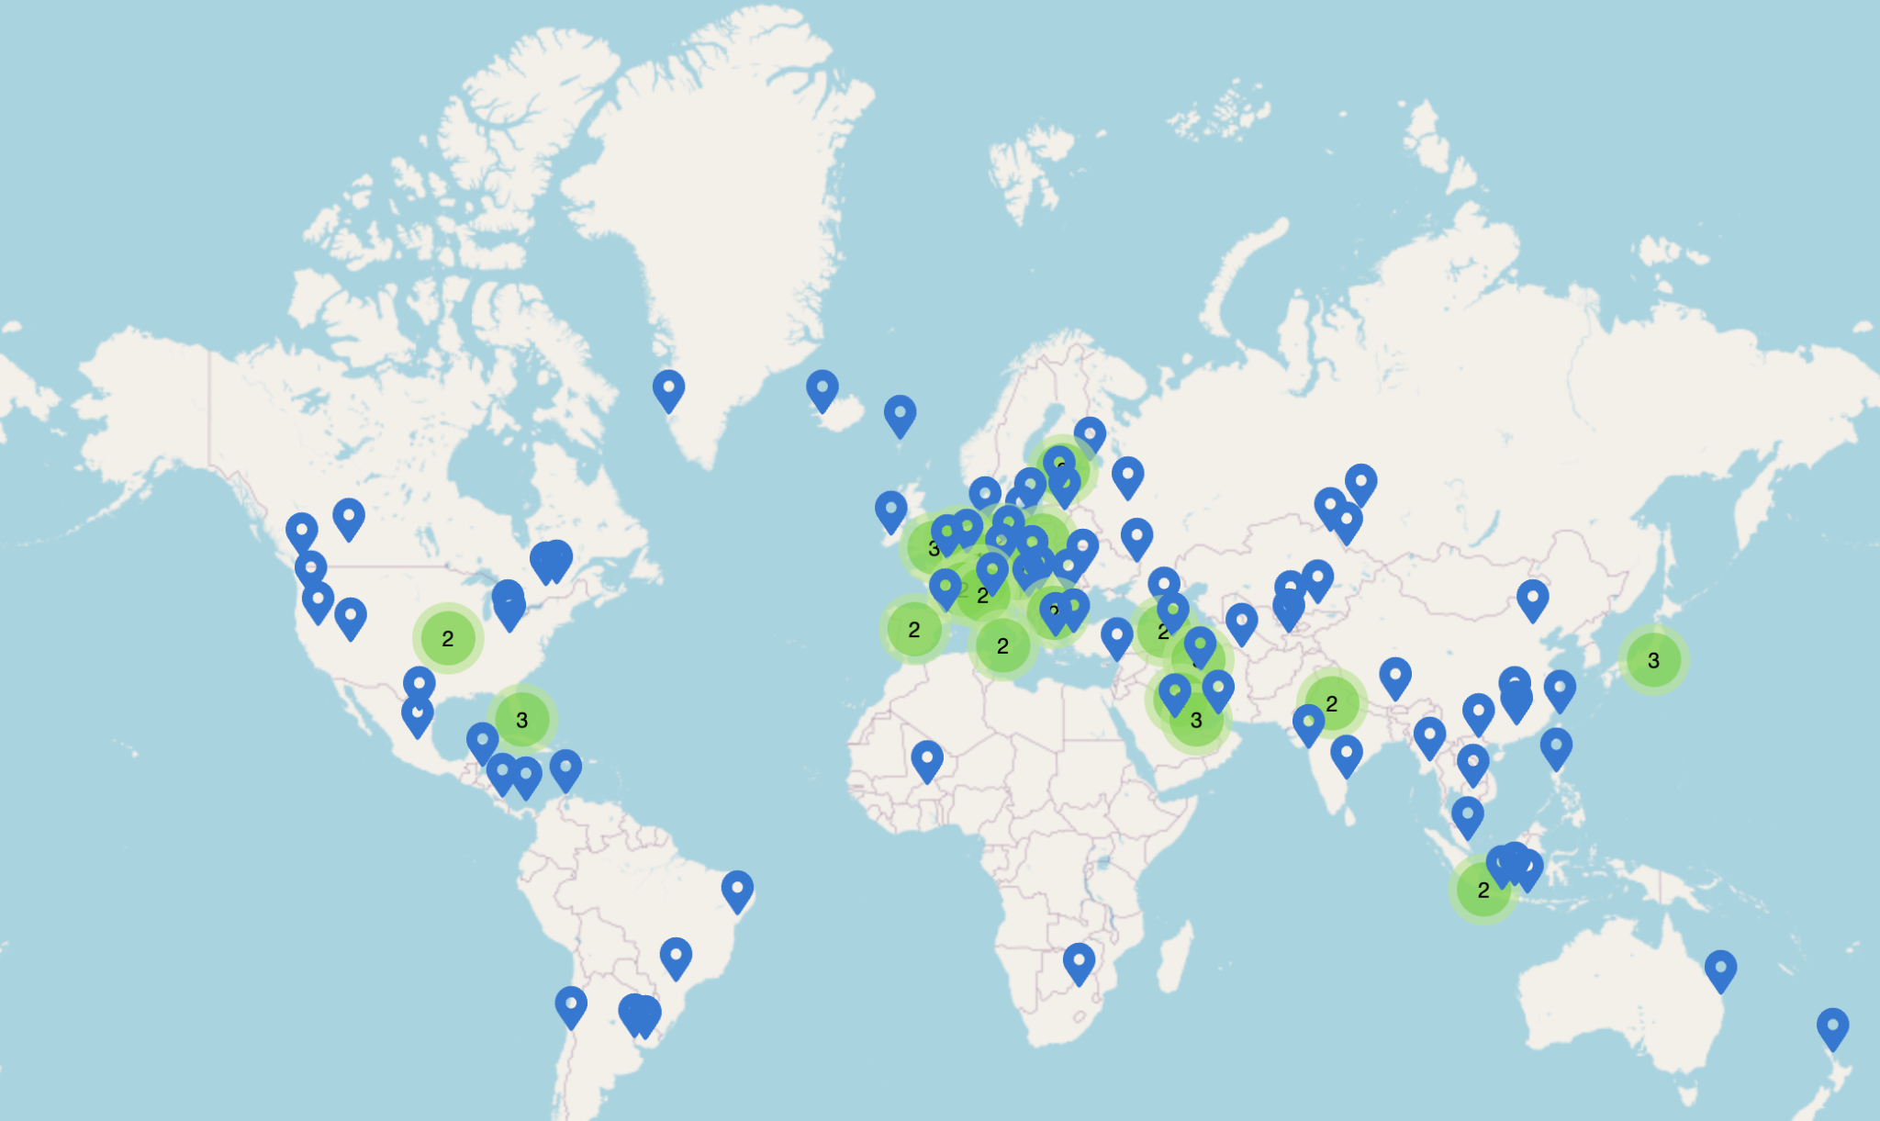
DNS
Lecture 14 (Applications 1)
Lecture 14, Spring 2026
Notes:
Slides template credit: Josh Hug, Lisa Yan

Slide 2
What is DNS For?
DNS
What is DNS For?
Design
Scaling
Other Uses
Lecture 14, CS 168, Spring 2026

Slide 3
Domain Names
Recall: Computers are addressed by IP address.
Example: 74.125.25.99.
Useful for machines: Helps making routing scalable.
Not useful for humans: Numbers not meaningful to humans. Hard to remember.
Alternative addressing system: Human-readable domain names.
Example: www.google.com.
Not useful for machines: Contains no relevant routing information.
Useful for humans: Meaningful words and phrases, easy to remember.
7
Application
(DNS, HTTP)
4
Transport
(TCP, UDP)
3
Network
(IP)
2
Data Link
(Ethernet)
1
Physical
(Optical fiber, copper)
Notes:
Lots of applications are built on the Internet infrastructure we've seen.
We'll focus on some common ones:
DNS (today).
HTTP (next time).

Slide 4
DNS: Definition
DNS (Domain Name System): An Internet protocol for translating human-readable domain names to IP addresses.
Usage:
You want to send a packet to a certain domain (e.g. you type a domain into your browser).
Your computer performs a DNS lookup to translate the domain name to an IP address.
Your computer sends the packet to the corresponding IP address.
www.google.com
DNS
74.125.25.99

Slide 5
Goals of DNS
DNS must be scalable.
Many hosts/names. Many lookups. Many updates.
DNS must be highly available.
No single point of failure.
DNS must be lightweight and fast.
Connections often start with a name lookup (e.g. user typing domain in browser).
If DNS is slow, every connection is slow.
www.google.com
DNS
74.125.25.99

Slide 6
DNS Design
DNS
What is DNS For?
Design
Scaling
Other Uses
Lecture 14, CS 168, Spring 2026

Slide 7
DNS Name Servers
Name server: A server on the Internet responsible for answering DNS requests.
Name servers have domain names and IP addresses too.
Example: There's a name server with name a.edu-servers.net and IP 192.5.6.30.
DNS is a client-server, request-response protocol.
To perform a DNS lookup, you (the client) send a DNS query: "What is the IP address of www.google.com?"
The name server sends a DNS response with the answer: "The IP address of www.google.com is 74.125.25.99."
Issues:
One name server can't handle every DNS request from the entire Internet.
If there are many name servers, how do you know which one to contact?

Slide 8
DNS Name Server Hierarchy
Idea #1: If one name server doesn't know the answer to your query, the name server can direct you to another name server.
Analogy: If I don't know the answer to your question, I will direct you to a friend who can help.
Idea #2: Arrange the name servers in a tree hierarchy.
Intuition: Name servers will direct you down the tree until you receive the answer to your query.
. (root)
.edu
.org
.com
hofstra.edu
mit.edu
cs161.org
piazza.com
google.com

Slide 9
DNS Name Server Hierarchy
Each box is a name server. The label represents which queries the name server is responsible for answering.
This name server is responsible for .edu queries like cs.hofstra.edu, but not a query like mail.google.com.
. (root)
.edu
.org
.com
hofstra.edu
mit.edu
cs161.org
piazza.com
google.com

Slide 10
Steps of a DNS Lookup
Let's walk through a DNS query for the IP address of cs.hofstra.edu.
. (root)
You
.edu
.org
hofstra.edu
mit.edu
cs161.org

Slide 11
Steps of a DNS Lookup
First, you check your cache to see if you already know the answer to your query.
Hmm, I don't know IP address of cs.hofstra.edu.
. (root)
You
.edu
.org
hofstra.edu
mit.edu
cs161.org

Slide 12
Steps of a DNS Lookup
DNS queries always start with a request to the root name server, which is responsible for all requests.
"What is the IP address of cs.hofstra.edu?"
. (root)
You
1
.edu
.org
hofstra.edu
mit.edu
cs161.org

Slide 13
Steps of a DNS Lookup
The root name server responds by directing you to the correct child name server (in this case, the .edu name server).
. (root)
You
1
2
"I don't know, but I have delegated authority to the .edu name server."
.edu
.org
hofstra.edu
mit.edu
cs161.org

Slide 14
Steps of a DNS Lookup
Next, you ask the same question, but now to the .edu name server.
. (root)
You
1
2
.edu
.org
3
"What is the IP address of cs.hofstra.edu?"
hofstra.edu
mit.edu
cs161.org

Slide 15
Steps of a DNS Lookup
The .edu name server redirects you to the hofstra.edu name server.
. (root)
You
1
2
.edu
.org
3
4
"I don't know. But I have delegated authority to the hofstra.edu name server."
hofstra.edu
mit.edu
cs161.org

Slide 16
Steps of a DNS Lookup
Next, you ask the same question, but now to the hofstra.edu name server.
. (root)
You
1
2
.edu
.org
3
4
5
hofstra.edu
mit.edu
cs161.org
"What is the IP address of cs.hofstra.edu?"

Slide 17
Steps of a DNS Lookup
The hofstra.edu name server responds with the answer.
You can cache the answer to avoid having to ask again later.
. (root)
You
1
2
.edu
.org
3
4
5
6
hofstra.edu
mit.edu
cs161.org
"The IP address of cs.hofstra.edu is 23.185.0.1."
Store this in your cache for the next 24 hours so you don't bother me again with the same request.

Slide 18
Stub Resolvers and Recursive Resolvers
In practice, your computer usually tells another resolver to perform the query for you.
Stub resolver: The resolver on your computer.
Only contacts the recursive resolver and receives the answer.
Recursive resolver: The resolver that makes the actual DNS queries.

Slide 19
Steps of a DNS Lookup (With Recursive Resolver)
Stub Resolver
1
The stub resolver sends the query to the recursive resolver.
. (root)
Recursive Resolver
.edu
.org
hofstra.edu
mit.edu
cs161.org

Slide 20
Steps of a DNS Lookup (With Recursive Resolver)
The recursive resolver contacts all the name servers to answer the query, as we saw earlier.
Stub Resolver
1
. (root)
2
Recursive Resolver
3
4
.edu
.org
5
6
hofstra.edu
mit.edu
cs161.org
7

Slide 21
Steps of a DNS Lookup (With Recursive Resolver)
Stub Resolver
The recursive resolver returns the final answer to the stub resolver.
1
8
. (root)
2
Recursive Resolver
3
4
.edu
.org
5
6
hofstra.edu
mit.edu
cs161.org
7

Slide 22
Recursive Resolvers
How do we know where the recursive resolver is?
When you first join the network, somebody can tell you a resolver address.
You can use a well-known resolver with a memorable IP address.
1.1.1.1 (operated by Cloudflare).
8.8.8.8 (operated by Google).
Why are recursive resolvers useful?
The recursive resolver can build a larger cache from multiple users' requests.
If you query for www.google.com for the first time, the recursive resolver might have the answer cached from somebody else's query.
Reduces load on name servers.
Recursive resolver asks the name server for www.google.com once, and can serve the answer to many users.
Recursive resolvers usually run by ISPs or application providers (Google, Cloudflare).
Notes:
What happens if a resolver breaks?
Anyone relying on 1.1.1.1 to resolve DNS queries cannot access webpages.
Resolvers can be a single point of failure!
Yesterday, 1.1.1.1 stopped responding.
Maybe a BPG issue?

Slide 23
DNS Uses UDP
Recall UDP vs. TCP:
UDP: Unreliable, but faster.
TCP: Reliable, but slower.
DNS should be lightweight and fast, so it uses UDP.
No 3-way handshake needed.
No need for servers to maintain connection state.
Most queries/responses fit in a single UDP packet (no bytestream needed).

Slide 24
DNS Uses UDP
What if a packet is dropped?
Set a timer, and retry on timeout.
Varies on different OSes, but can be fairly slow.
This is why resolvers need to be highly-available.
What if a message doesn't fit in a UDP packet?
Generally never happens on typical requests and responses.
Larger messages can be sent over TCP.
Recent advances in DNS use a secure transport protocol, with encryption.
TCP and UDP are vulnerable to attackers.

Slide 25
Scaling DNS
DNS
What is DNS For?
Design
Scaling
Other Uses
Lecture 14, CS 168, Spring 2026

Slide 26
DNS Hierarchy
The DNS tree represents 3 forms of hierarchy.
Names are hierarchical. This is why our domain names are words separated by dots.
. (root)
edu
hofstra
ischool
math
eecs
pink.ischool.hofstra.edu.
pink
repo
rise
rise.cs.hofstra.edu.

Slide 27
DNS Hierarchy
Authority is hierarchical. Each organization manages a zone, and can delegate parts of the zone to other organizations.
. (root)
edu
Hofstra owns the hofstra.edu zone.
hofstra
ischool
math
eecs
Hofstra gives the cs.hofstra.edu zone to the EECS department.
pink
repo
rise

Slide 28
DNS Hierarchy
Infrastructure is hierarchical. Each name server only needs to know about a subset of domains.
. (root)
I have to answer all hofstra.edu queries.
For cs.hofstra.edu queries, I can redirect users to that name server.
edu
hofstra
ischool
math
eecs
pink
repo
rise

Slide 29
DNS Hierarchy
Each node in the tree represents a zone of domains.
An organization managing a zone can delegate part of its zone to somebody else.
Each zone has an authoritative name server that knows about the domains in that zone.
The hofstra.edu zone
Owned by: Hofstra
Name server: adns1.hofstra.edu
Manages:
www.hofstra.edu
calcentral.hofstra.edu
systemstatus.hofstra.edu
...
The ischool.hofstra.edu zone
Owned by: School of Information
Name server: is-dns.hofstra.edu
Manages:
pink.ischool.hofstra.edu
blue.ischool.hofstra.edu
...
The cs.hofstra.edu zone
Owned by: EECS Department
Name server: cs-dns.hofstra.edu
Manages:
repo.cs.hofstra.edu
rise.cs.hofstra.edu
...

Slide 30
DNS Hierarchy
A zone corresponds to an administrative authority response for some part of the hierarchy.
A zone is authoritative for how names within that part of the hierarchy are controlled.
You can choose to delegate authority for part of the zone to somebody else.
Zones help DNS scale.
Different administrative authorities are responsible for different parts of the hierarchy.

Slide 31
Administrative Authorities
The DNS root is controlled by ICANN.
Internet Corporation for Assigned Names and Numbers.
. (root)
...
com
edu
org
uk
fr
jp
...
co
ac
google
amazon

Slide 32
Administrative Authorities
Top-level domains (TLDs) are the zones directly below root.
Historically, relatively few, based on purpose (organization, education, commercial, etc.), and country (UK, France, Japan, etc.).
More recently, many more weird ones (.travel, .pizza, etc.). Over 1500 TLDs today!
. (root)
TLDs
...
com
edu
org
uk
fr
jp
...
co
ac
google
amazon

Slide 33
Administrative Authorities
Second-level domains, third-level domains, etc. are below TLDs.
Each TLD can decide its own structure.
Example: The .uk zone delegated .co.uk (commercial) and .ac.uk (academic).
. (root)
TLDs
...
com
edu
org
uk
fr
jp
...
Second-level domains
co
ac
Third-level domains
google
amazon

Slide 34
Administrative Authorities
Users can lease specific domains from domain registries (e.g. Verisign).
If you want to host your website on example.com, you have to reserve the domain for a recurring (e.g. monthly) fee.
Then, the authoritative .com name servers add a record mapping example.com to your IP address.
Organizations (e.g. Google, Amazon) can operate their own zones, with their own name servers.
The organization has to tell its parent about its name server(s).
Then, the parent will redirect queries to the organization.

Slide 35
Zone Availability
Recall: Each zone has several name servers for redundancy.
Each zone has two authoritative name servers.
This ensures availability of that zone.
The name servers work in a primary/secondary model.
The primary name server manages and updates the actual records.
The secondary name server uses a read-only copy of the primary server's records.
The primary server periodically transfers its records to the secondary servers.
Transfer can be large! This is where DNS might use TCP instead of UDP.
Notes:
"Must" = it's standard practice, and many registrars require it.

Slide 36
Root Zone Availability with Anycast
It would be really bad if the root servers were unavailable.
Someone with an empty cache would be unable to make any lookups.
Root servers use a trick called anycast to ensure high availability.
There are only 13 root-server domains (a.root-servers.net to m.root-servers.net).
But, there are actually thousands of root servers.
Anycast: Use the same IP address for many servers on the Internet.
Thousands of servers all claim to be k.root-servers.net with address 193.0.14.129 in routing protocols.
You might hear advertisements from many different servers. You can pick any route (e.g. the shortest one), and you'll reach one of the root servers.
Anycast can also be used for other highly-available services (e.g. the 8.8.8.8 resolver).

Slide 37
Root Zone Availability with Anycast
All of these servers are advertising themselves as k.root-servers.net, with IP 193.0.14.129.
Lots of cooperation between network operators to keep root servers highly available.
Which instance am I actually using?
$ dig +short +norec @k.root-servers.net hostname.bind chaos txt
"ns1.us-mia.k.ripe.net"
"us-mia" is probably Miami, Florida.
Notes:
https://www.ripe.net/analyse/dns/k-root/

Slide 38
Other Uses of DNS
DNS
What is DNS For?
Design
Scaling
Other Uses
Lecture 14, CS 168, Spring 2026

Slide 39
DNS for Load-Balancing
Multiple servers with different IP addresses can all host the same application.
Useful for popular services (e.g. YouTube, Twitter).
The name server can return multiple IP addresses for a single domain.
No precedence between these different A records.
Client can pick any of them. We often pick the first one.
Server shuffles the order in the response.
Provides coarse-grained load-balancing across different servers.
Provides simple resiliency. If one IP is down, pick another.
;; ANSWER SECTION:
microsoft.com. 1999 IN A 20.112.250.133
microsoft.com. 1999 IN A 20.231.239.246
microsoft.com. 1999 IN A 20.76.201.171
microsoft.com. 1999 IN A 20.70.246.20
microsoft.com. 1999 IN A 20.236.44.162

Slide 40
DNS for Load-Balancing
The name server can give different responses based on where the query came from.
Server needs extra logic: "If the query is from X, reply with Y."
How do we determine which response to give?
Address of the recursive resolver.
Most clients don't directly query name servers.
Address of the client.
Requires extension to DNS to carry client address.
Geographical location of the client.
Requires database to map IP addresses to physical locations, e.g. MaxMind.
From California:
From Oregon:
$ dig google.com +short
142.251.46.238
$ dig google.com +short
74.125.135.113

Slide 41
DNS for Load-Balancing
Challenges with geographical load-balancing:
Ideally, we want to direct the client to the "nearest" server.
We don't know the how "far" the user is from the server.
We don't know the geographic distance.
We don't know the network distance (e.g. number of hops).
We don't know the performance between the user and the server.
What's the bandwidth and latency of the links between user and server?
Some guessing is involved.
Some proprietary logic is required at the name server.

Slide 42
DNS for Load-Balancing
Load-balancing experiment:
From San Francisco, ask for the IPv6 address of www.youtube.com.
Look up the name corresponding to that specific IP address.
sfo03s25-in-x0e.1e100.net. "SFO" = San Francisco...pretty close!
Another load-balancing experiment:
From Oregon, ask for the IPv6 address of www.youtube.com.
San Francisco → IP address from San Francisco request = 20 ms RTT.
San Francisco → IP address from Oregon request = 35 ms RTT.
Mapping logic gave us a way to map a client to a better-performing server.
Doing a "reverse" DNS lookup from IP address to hostname:
$ host 2607:f8b0:4005:80d::200e
e.0.0.2.0.0.0.0.0.0.0.0.0.0.0.0.d.0.8.0.5.0.0.4.0.b.8.f.7.0.6.2.ip6.arpa domain
name pointer sfo03s25-in-x0e.1e100.net.

Slide 43
Summary: DNS
DNS was created to allow for name to IP address resolution.
Helps humans easily access things on the Internet.
DNS is a hierarchical system.
Zones and name servers have a hierarchy.
Allows for delegation to authoritative entities.
DNS is implemented over UDP.
DNS extends beyond address resolution into service resolution (e.g. email).
DNS can be used for load-balancing.

